Slide 1
DI-322 Web Technologies
Introduction: Web Applications
TCP/IP Application Services

Slide 2
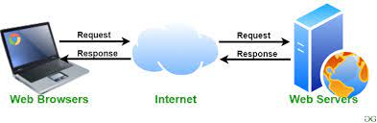
2. Web Servers :
Basic Operation:
Definition: Web servers are software applications or hardware devices that deliver content, such as web pages, to users over the internet.
Explanation:
Web servers receive requests from clients (such as web browsers) for web resources (like HTML pages, images, etc.).
They process these requests, fetching the requested resources from the file system or generating them dynamically through applications.
Finally, they send the resources back to the client over the internet.
Example: Apache HTTP Server, Nginx, Microsoft IIS.

Slide 3
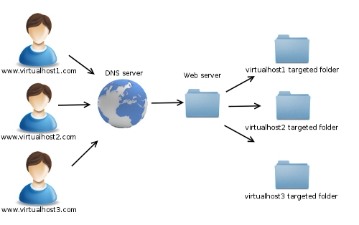
2. Web Servers :
Virtual Hosting:
Definition: Virtual hosting is a method where a single web server hosts multiple domain names on the same physical machine, distinguishing between them based on their domain names.
Explanation:
With virtual hosting, one physical server can serve multiple websites with different domain names.
The server uses the HTTP Host header to determine which website's content to serve in response to a request.
Example: A single web server hosting example.com, example.net, and example.org on the same machine.

Slide 4
2. Web Servers :
Chunked Transfers:
Definition: Chunked transfer encoding is a method in which data is sent in a series of chunks instead of being sent all at once.
Explanation:
Chunked transfers allow the server to start sending a response before it knows the total size of the resource being requested.
This is useful for dynamically generated content or for transmitting large files where the size may not be known in advance.
Example: Streaming video or audio content over HTTP.

Slide 5
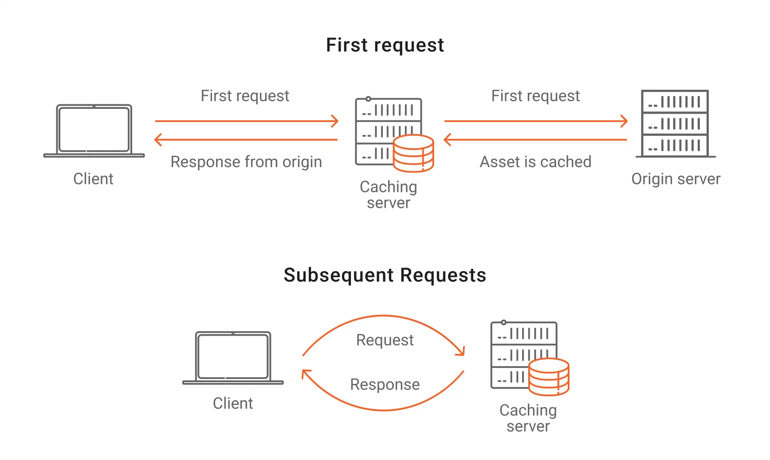
2. Web Servers :
Caching Support:
Definition: Caching is the process of storing copies of web resources temporarily to reduce bandwidth usage, server load, and latency.
Explanation:
Web servers can specify caching directives in HTTP headers to instruct browsers or intermediary servers to cache certain resources.
Cached resources can be reused without fetching them again from the origin server if they haven't expired.
Example: Browsers caching images, stylesheets, and scripts to speed up subsequent page loads.

Slide 6
2. Web Servers :
Extensibility:
Definition: Extensibility refers to the ability of a web server to be easily customized or extended with additional functionality.
Explanation:
Web servers often support plugins, modules, or scripting languages that allow developers to add new features or customize existing behavior.
This enables the server to adapt to different requirements or integrate with other systems.
Example: Apache HTTP Server's module system allows developers to extend its functionality with modules for authentication, adjusting software changes, and more.

Slide 7
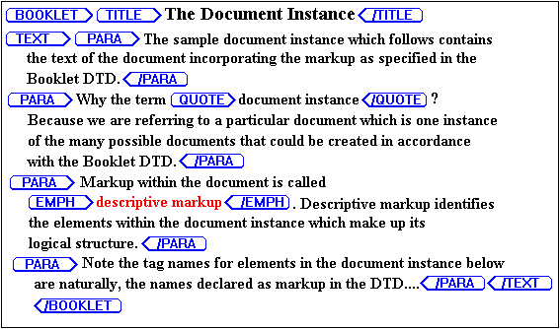
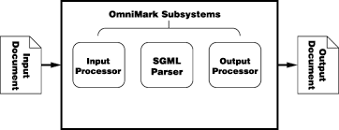
3. SGML (Standard Generalized Markup Language):
SGML is a markup language used for defining the structure and semantics of documents.
It's a standard for how to specify a document markup language or tag set.
SGML provides a framework for defining markup languages for documents, allowing for the separation of content and presentation.

Slide 8
4. HTML5 (Hypertext Markup Language version 5):
HTML5 is the latest version of the HTML standard, used for structuring and presenting content on the World Wide Web.
It includes new features such as semantic elements (like <header>, <footer>, <nav>), audio and video elements, canvas for drawing graphics, and support for local storage.
HTML5 provides better support for multimedia, offline web applications, and improved accessibility compared to previous versions.

Slide 9
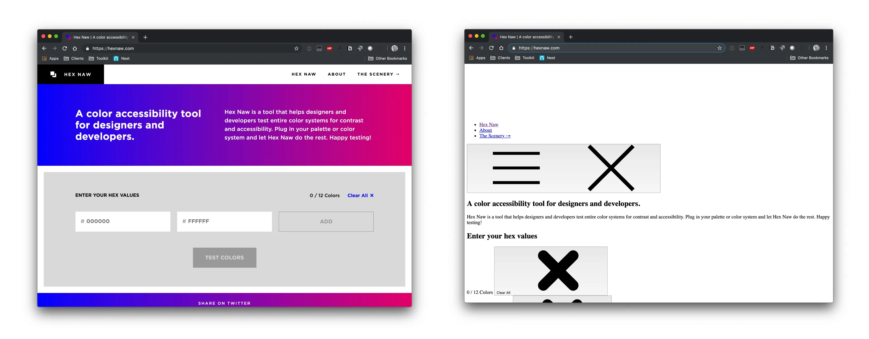
5. CSS3 (Cascading Style Sheets version 3):
CSS3 is the latest version of the CSS standard, used for styling the presentation of HTML and XML documents.
It introduces new features such as rounded corners, gradients, animations, transitions, and media queries.
CSS3 allows for more sophisticated and visually appealing designs without the need for additional scripting or images.

Slide 10
7. XML Languages and Applications: Core XML, XHTML, XHTM MP
Core XML:
Definition: eXtensible Markup Language, defines a set of rules for encoding documents in a format that is both human-readable and machine-readable.
Explanation:
Core XML provides a framework for defining custom markup languages tailored to specific needs.
It uses tags to define elements and attributes to provide additional information about those elements.
Core XML facilitates the exchange of structured data between different systems, platforms, and applications.
Applications: Core XML is used in a wide range of applications such as:
Data interchange between different software systems and platforms.
Configuration files for software applications.
Representing structured data in web services and APIs.
Storing and exchanging data in databases and document repositories.

Slide 11
7. XML Languages and Applications: Core XML, XHTML, XHTM MP
XHTML (Extensible Hypertext Markup Language):
Definition: XHTML is a stricter and cleaner version of HTML, reformulated in XML syntax.
Explanation:
XHTML combines the flexibility of HTML with the stricter syntax rules of XML.
It follows XML rules, such as requiring all elements to be properly nested and closed, making it more consistent and easier to process by XML parsers.
XHTML documents are written using XML syntax, which makes them compatible with other XML-based technologies and tools.
Applications: XHTML is commonly used in:
Web development, especially for creating well-structured and semantic web pages.
Mobile web development, as it facilitates the creation of web pages that are compatible with various devices and platforms.
Integration with XML-based technologies and tools for processing and manipulating web content.

Slide 12
7. XML Languages and Applications: Core XML, XHTML, XHTM MP
XHTML MP (XHTML Mobile Profile):
Definition: XHTML MP is a mobile-specific version of XHTML designed for mobile devices with limited resources and capabilities.
Explanation:
XHTML MP is optimized for mobile browsing, offering a lightweight and simplified markup language tailored to the constraints of mobile devices.
It includes features such as support for small screens, limited bandwidth, and simplified navigation.
XHTML MP is designed to provide a consistent user experience across different mobile devices and platforms.
Applications: XHTML MP is used in:
Mobile web development, enabling the creation of web pages that are optimized for viewing on mobile devices.
Mobile applications and services, providing a standard markup language for delivering content to mobile users.
Integration with mobile browsers and platforms, ensuring compatibility and consistency in rendering web content on various mobile devices.

